Slide 1
Flight of the osprey
Altitude data

Slide 2
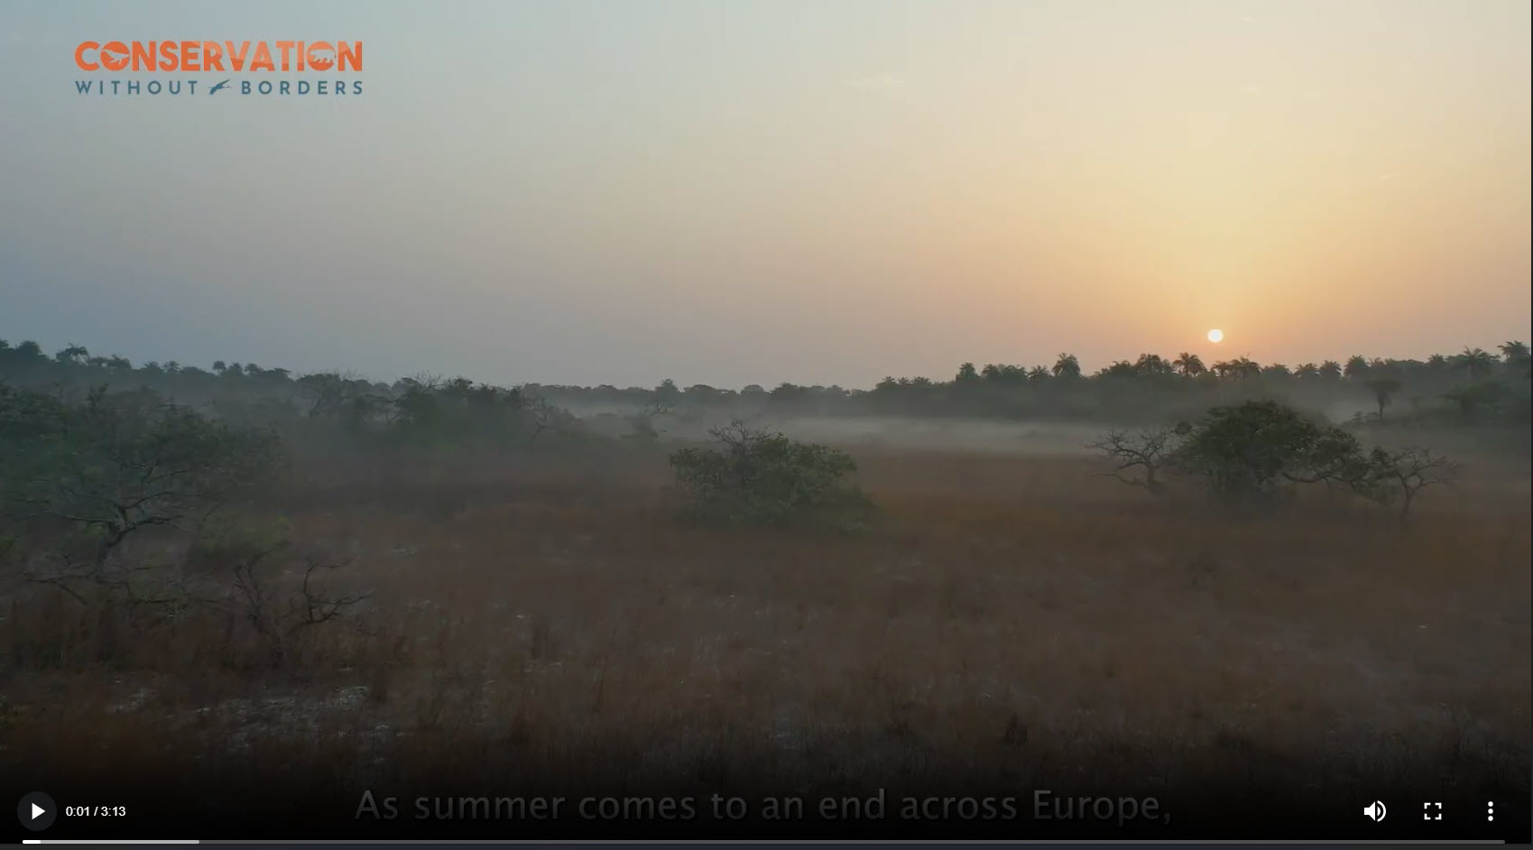
Learning hook
Watch this video to find out about the ‘Flight of the osprey’ project.
The project tracks the osprey, a bird of prey that migrates from the United Kingdom to Guinea, Africa.
The project gathers vital data on threats to this iconic bird and other migratory species.
View video about the osprey
Notes:
View video about the osprey https://vid.cdn-website.com/7aa06bb4/videos/QkBqFRK0QJmqzL1BwPiQ_16x9-TRAILER-CWB-FINAL-SUBSWEB-v.mp4

Slide 3
Meet Sacha Dench
My team and I use scientific data including tracking data, aerial photography and video of critical sites.
We also collect anecdotal data by speaking to all kinds of people that live or work in and on these sites.
I am involved in research to understand what threatens different migratory species. ​
Image © 2024 Conservation Without Borders. Permission granted.

Slide 4
Welcome to the team!
I invite you to help our team as a junior researcher.
Image © 2024 Conservation Without Borders. Permission granted.

Slide 5
About the osprey
Osprey facts
Scientific name: Pandion haliaetus
They are a bird of prey (raptor).
They feed mostly on fish (piscivore).
They are migratory birds in some parts of the world and sedentary (non-migrating) in other parts.
In Australia, osprey are not generally a migrating species but do move around the coastal regions in search of food.
Source:
https://commons.wikimedia.org/wiki/File:Pandion_global_range.svg

Slide 6
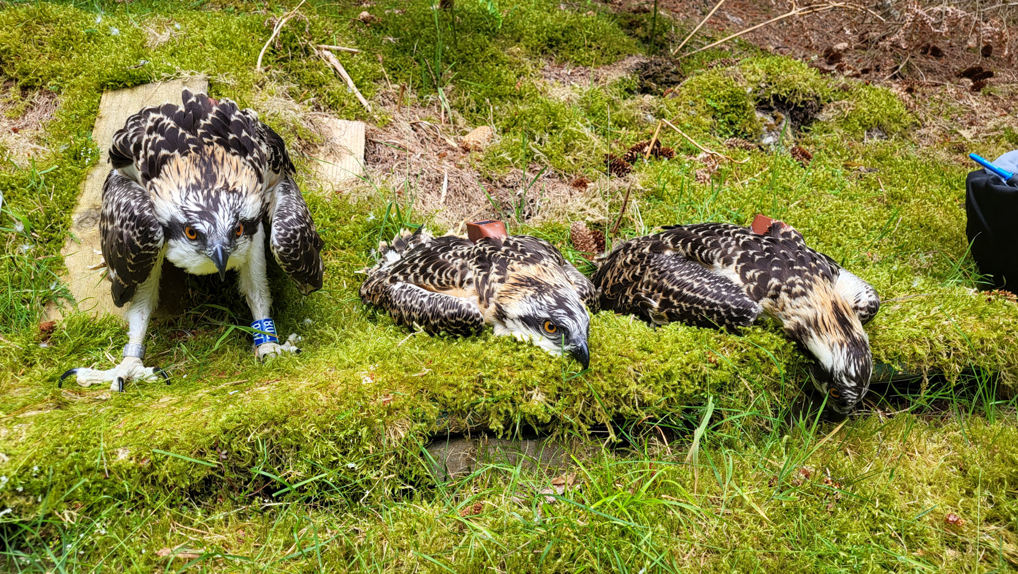
Let's get started
Osprey tag number (Glen) | Date | Latitude | Longitude | Maximum altitude in metres
224458 | 8/07/2022 | 55°N | 3°W | 115
224458 | 9/07/2022 | 55°N | 3°W | 120
224458 | 10/07/2022 | 55°N | 3°W | 120
224458 | 11/07/2022 | 55°N | 3°W | 241
224458 | 12/07/2022 | 55°N | 3°W | 415
224458 | 13/07/2022 | 55°N | 3°W | 373
224458 | 14/07/2022 | 55°N | 3°W | 386
Glen is a fledgling learning to fly.
Look at the data in the table.
What do you notice?
What do you wonder? ​
Images © 2024 Conservation Without Borders. Permission granted.

Slide 7
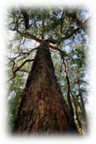
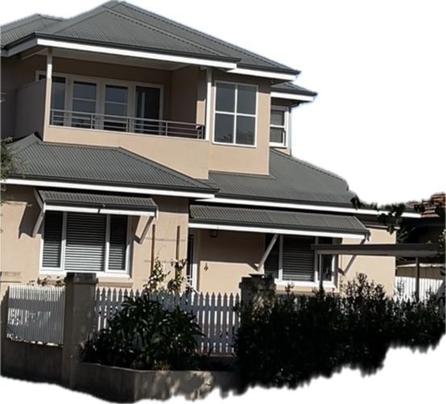
Altitude
International Towers, Barangaroo, Sydney​
Tower One, 217 metres tall (49 floors).
Describe the altitude (height above the ground) reached by the osprey using these objects.
Image © 2024 Conservation Without Borders. Permission granted.
Date | Altitude in metres
8/07/2022 | 115
9/07/2022 | 120
10/07/2022 | 120
11/07/2022 | 241
12/07/2022 | 415
13/07/2022 | 373
14/07/2022 | 386
Source: N McGeachie
A very tall tree is about 70 metres in height.
Pixabay Tall eucalypt
A two-storey house is about 9 metres in height.
Source: N McGeachie

Slide 8
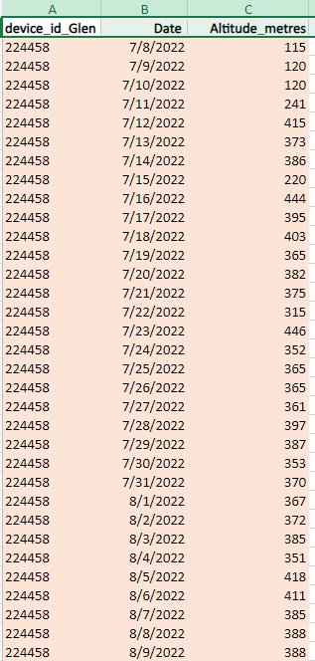
Altitude data
You will be given this table of data.
I need a graph of the data for my report.
Can you also describe some key points about what the data shows?
When looking at the altitude data, what is the mode? (That is, the value that appears the most in the dataset.)
Image © 2024 Conservation Without Borders. Permission granted.

Slide 9
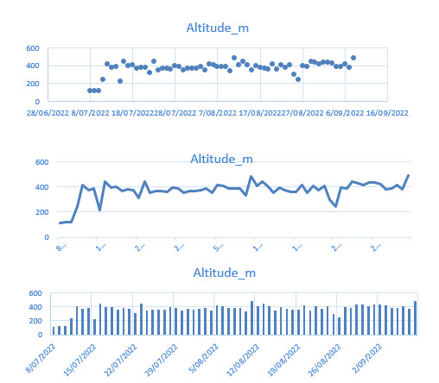
Choosing the graph type
Look at these types of graphs. Which graph is best suited to displaying the altitude data?
Image © 2024 Conservation Without Borders. Permission granted.
Notes:
Discuss that the data is not continuous. For example, data for the temperature over a day is continuous data. Often a line graph is a useful way to show that data over time. In our example, a line graph is not suitable.
A dot plot is a reasonable way to show the data in our example.
A column graph would be considered a standard way to represented the altitude data.
Image © 2024 Conservation Without Borders. Permission granted.

Slide 10
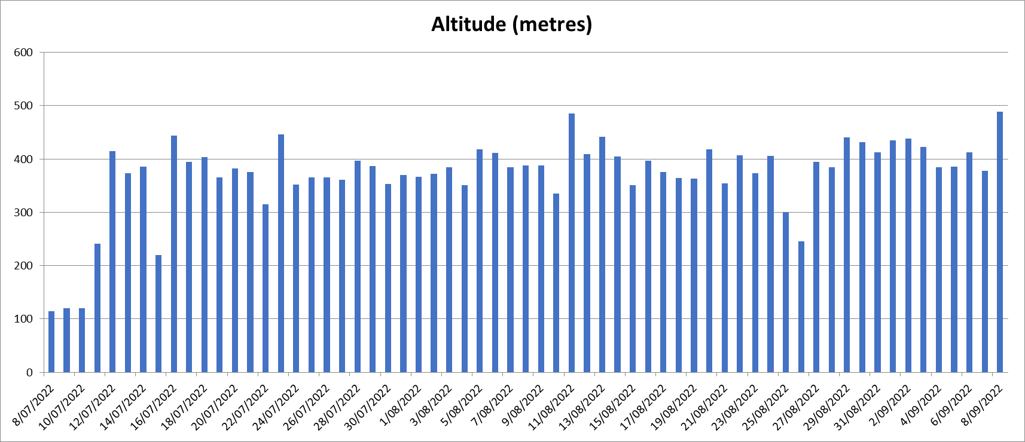
Your completed graph
Notes:
Discuss the title and what a better title might be.
Discuss what the labels should be for the x and y axis, for example, x axis time in days and y axis altitude (height in metres).
Remind students that a column graph would be considered a standard way to represented the altitude data.

Slide 11
Research complete (for now!)
Thanks for your help today!​
I may call on you again.
Image © 2024 Conservation Without Borders. Permission granted.

