Slide 1
Discounts
Mathematical modelling

Slide 2
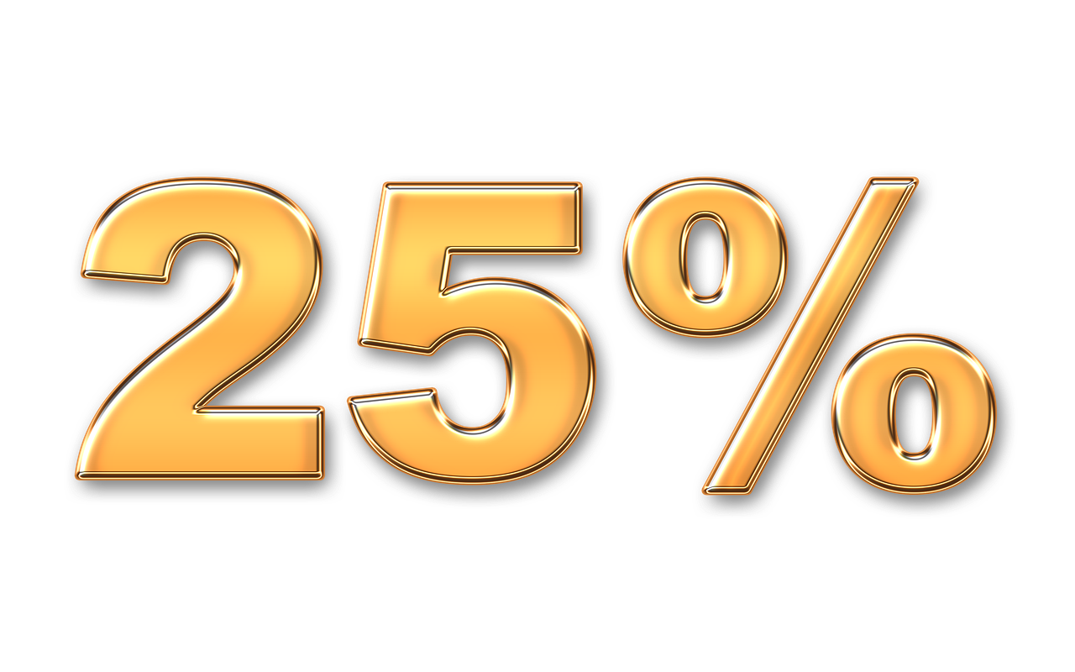
What do you notice? What do you wonder?
Notes:
Example notice and wonderings
Notice:
You often see these as discounts in stores.
50% is the largest percentage and it means a half.
Three sales are percentages; one is not.
The percentages are all different number amounts: 10, 25 and 50.
25% is the same as one-quarter.
Wonder:
I wonder which sale saves the most money for different types of purchases?
I wonder how the buy-one-get-one-free deal compares to a percentage discount, such as 25% or 50% off?
I wonder what happens the more expensive the item on sale?
Check:
Do students connect 10% and its fraction equivalent, one-tenth?
Similarly, do students connect that 25% is one-quarter, and 50% is one-half?
Can they model buy-one-get-one-free with an example to show the total cost?
https://pixabay.com/illustrations/percent-discount-offer-sale-7745614/
https://pixabay.com/illustrations/buy-1-get-1-free-buy-get-add-7139286/
https://pixabay.com/illustrations/sale-reduction-discount-business-1726232/
https://pixabay.com/illustrations/sale-bargain-shopping-bag-4576524/

Slide 3
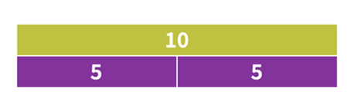
How would you work this out? Which calculation strategy do you prefer?
50% is the same as ½.
To find half of 10, divide 10 by 2.
10 ÷ 2 = 5.
So, 50% of 10 is 5.
50% can be written as the decimal 0.5.
Multiply 10 by 0.5.
10 × 0.5 = 5.
So, 50% of 10 is 5.
What is 50% of 10?
Using mental maths,
partition 10 into
two equal parts.
Half of 10 is 5.
So, 50% of 10 is 5.
Partition the bar into two equal parts, as 50% means half.
Notes:
Ask students which calculation strategy they prefer.
There are a number of different ways to work out 50% of 10.
Using fractions and division
50% is the same as ½.
To find half of 10, divide 10 by 2.
10 ÷ 2 = 5.
So, 50% of 10 is 5.
Using decimals and multiplication
50% can be written as the decimal 0.5.
Multiply 10 by 0.5: 10 × 0.5 = 5.
So, 50% of 10 is 5.
Partitioning using mental maths
Break 10 into two equal parts.
Half of 10 is: 5.
So, 50% of 10 is 5.
All methods give the same result: 50% of 10 is 5.
Partitioning using bar model
Partition the bar into two equal parts, as 50% means half.

Slide 4
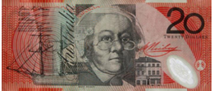
Impact of sales offer
How does each sale offer affect the price you pay for an item?
Use your preferred calculation strategy.
Sales offer
Original price
Discount
Discounted price
Image credits: Alamy Stock Photo/Melissa Jooste, Sale icons Pixabay
Notes:
Start with the original price of $20.00.
50% off: Discount is $10.00, discounted price is $10.00 (saving $10.00)
10% off: Discount is $2.00, discounted price is$18.00 (saving $2.00)
25% off: Discount is $5.00, discounted price is $15.00 (saving $5.00)
Buy-one-get-one-free: $20.00 (assuming you get two items for $20.00, so it feels like you're paying $10.00 per item)
https://pixabay.com/illustrations/percent-discount-offer-sale-7745614/
https://pixabay.com/illustrations/buy-1-get-1-free-buy-get-add-7139286/
https://pixabay.com/illustrations/sale-reduction-discount-business-1726232/
https://pixabay.com/illustrations/sale-bargain-shopping-bag-4576524/

Slide 5
Calculating the discount
Sales offer
Original price
Discount | $10.00 | $2.00 | $5.00 | $10.00
Discounted price
Image credits: Alamy Stock Photo/Melissa Jooste, Sale icons Pixabay
Notes:
Start with the original price of $20.00.
50% off: Discount is $10.00, discounted price is $10.00 (saving $10.00)
10% off: Discount is $2.00, discounted price is $18.00 (saving $2.00)
25% off: Discount is $5.00, discounted price is $15.00 (saving $5.00)
Buy-one-get-one-free: $20.00 (assuming you get two items for $20.00, so it feels like you're paying $10.00 per item)
https://pixabay.com/illustrations/percent-discount-offer-sale-7745614/
https://pixabay.com/illustrations/buy-1-get-1-free-buy-get-add-7139286/
https://pixabay.com/illustrations/sale-reduction-discount-business-1726232/
https://pixabay.com/illustrations/sale-bargain-shopping-bag-4576524/

Slide 6
Calculating the discounted price
Sales offer
Original price
Discount | $10.00 | $2.00 | $5.00 | $10.00
Discounted price | $10.00 | $18.00 | $15.00 | Get two items, each item is $10.00
Image credits: Alamy Stock Photo/Melissa Jooste, Sale icons Pixabay
Notes:
Start with the original price of $20.00.
50% off: Discount is $10.00, discounted price is $10.00 (saving $10.00)
10% off: Discount is $2.00, discounted price is$18.00 (saving $2.00)
25% off: Discount is $5.00, discounted price is $15.00 (saving $5.00)
Buy-one-get-one-free: $20.00 (assuming you get two items for $20.00, so it feels like you're paying $10.00 per item)
https://pixabay.com/illustrations/percent-discount-offer-sale-7745614/
https://pixabay.com/illustrations/buy-1-get-1-free-buy-get-add-7139286/
https://pixabay.com/illustrations/sale-reduction-discount-business-1726232/
https://pixabay.com/illustrations/sale-bargain-shopping-bag-4576524/

Slide 7
Have you ever wondered?
How does choosing sale items affect your grocery costs over a year?
Marco buys items as he needs them and usually doesn't wait for sales. At times, he finds an item on sale.
Marie shops for specials and waits for sale items. She always gets a bargain.
Icons: flaticon
Notes:
Introduce this scenario:
Two people approach shopping in different ways.
• Marie shops for specials and waits for sale items. She always gets a bargain.
• Marco prefers to buy when he needs something and prefers not to wait. Sometimes, when he shops, he finds an item on sale, but not often.
Ask: ‘How does choosing sale items affect your grocery costs over a year?’

Slide 8
Sale items
Item | Normal price | Discount % | Discount amount | Discounted price
Laundry liquid detergent | $26.00 | 50% off
Toothpaste | $9.00 | 50% off
Butter chicken with rice | $7.00 | 10% off
Apple crumble scrolls | $9.00 | 20% off
Orange mineral water | $2.50 | 40% off
Tea bags | $5.80 | 50% off
Margarine | $6.00 | 20% off
Pasta sauce | $4.00 | 10% off
Pasta | $3.50 | 20% off
Peanut butter | $7.50 | 30% off
Bread | $4.50 | 10% off
Fresh strawberries | $6.00 | 20% off
Cauliflower | $4.50 | 30% off
Notes:
Introduce this scenario.
Two people approach shopping in different ways.
• Marie shops for specials and waits for sale items. She always gets a bargain.
• Marco prefers to buy when he needs something and prefers not to wait. Sometimes, when he shops, he finds an item on sale but not often.
Does choosing sale items affect your grocery costs over a year?

Slide 9
Introducing the 4-STEP PROBLEM-SOLVING MODEL

Slide 10
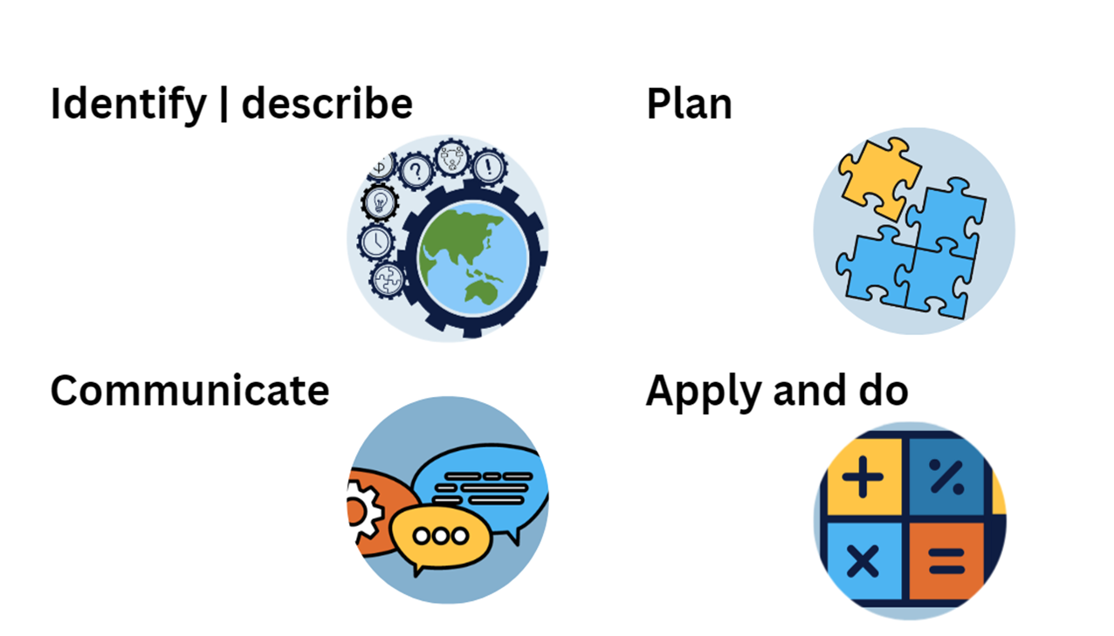
Using the 4-STEP PROBLEM-SOLVING MODEL
How does choosing sale items affect your grocery costs over a year?

Slide 11
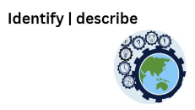
STEP 1
How does shopping for sales versus buying as needed impact overall spending?
What numbers or pieces of information do you need to represent the problem mathematically?
For example, weekly grocery costs, percentage saved on sale items, frequency of sales and total spending over a year.

Slide 12
STEP 2
How might you use these approaches?
Create a table to compare their spending every week.
Create a stacked column graph to show item cost and savings.
Use a spreadsheet to calculate their total spending for a week, month and year.
Compare the long-term savings of two different shopping habits.
Focus on how much each person saves rather than how much they spend.

Slide 13
STEP 3
Apply calculation strategies:
Calculate percentages
Weekly, monthly and yearly savings
Solve the problem using a series of steps.
Create a representation of your mathematical solution.

Slide 14
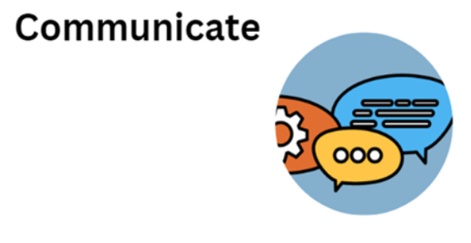
STEP 4
Share your solution:
How does choosing sale items affect your grocery costs over a year?
How does your solution compare to those of other students?
Explain why you chose your method of modelling the problem.

