Slide 1
Ways to record
Recording observational data of the bilby (mankarr)
Notes:
This unit of learning/lessons are developed through the kind permission of Kanyirninpa Judurrpa and Martu and who are the Intellectual Property and copyright owners.

Slide 2
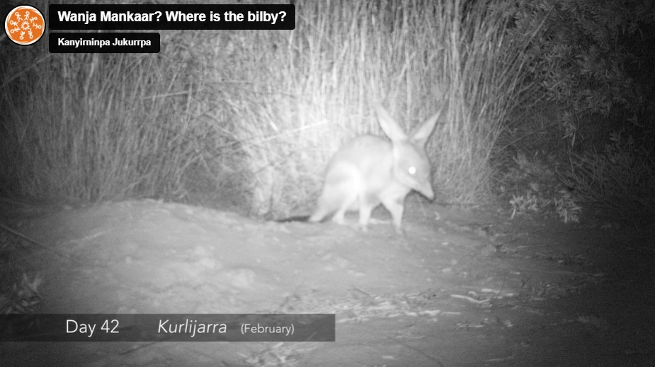
Wanyja Mankarr: Where is the bilby?
What data can we collect from the video?
Wanyja Mankarr: Where is the bilby
Notes:
Use this video for students to watch the video to acquire and record data about animal observations

Slide 3
Data from the video
The video displays information about:
month (Martu language)
animal type (Martu language)
night or day
day of sighting.

Slide 4
Tallying data of sightings
Animal type | Sightings (tally) | Totals
mankarr (bilby)
pujikatu (wild cat)
parnajarrpa (sand goanna)
kamalpa (camel)
turru (button quail)
warnapari (dingo)
Notes:
This is a simple table to record animal species using tally marks.
Model how to use tally marks to ensure accurate recording of observations
Draw a line through 4 tally marks to mark a group of 5, this makes it easy to count totals.

Slide 5
Tallying data of sightings (day and night)
Animal type | Day | Night | Totals
mankarr (bilby)
pujikatu (wild cat)
parnajarrpa (sand goanna)
kamalpa (camel)
turru (button quail)
warnapari (dingo)
Notes:
This form of recording organises data into day and night to show which animals were nocturnal

Slide 6
Tallying data of sightings (seasons)
Animal type | Kurlijara January | Kurlijara February | Kurlijara March | Wantajarra April | Wantajarra May | Wantajarra June | Totals
mankarr (bilby)
pujikatu (wild cat)
parnajarrpa (sand goanna)
kamalpa (camel)
turru (button quail)
warnapari (dingo)
Notes:
There may be a pattern of observations that is evident during seasons.

Slide 7
Tallying data of sightings (day order)
Animal type | 1st | 2nd | 3rd | 4th | 5th | 6th | 7th | 8th | 9th | 10th | Include more columns | Totals
mankarr (bilby) | Day 7
pujikatu (wild cat)
parnajarrpa (sand goanna)
kamalpa (camel)
turru (button quail)
warnapari (dingo)
Notes:
This data recording enables students to create a visual timeline which can provide an interesting view of the observations.

